Slide 1
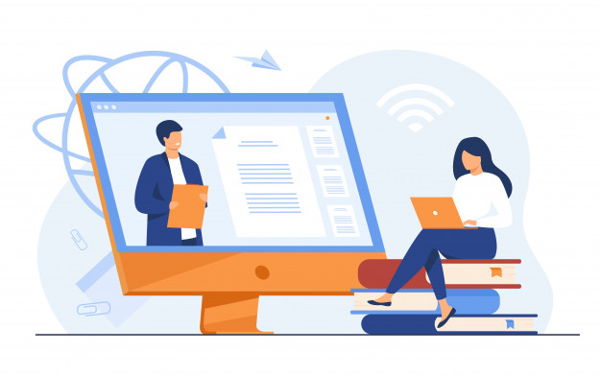
Social Media and Me

Slide 2
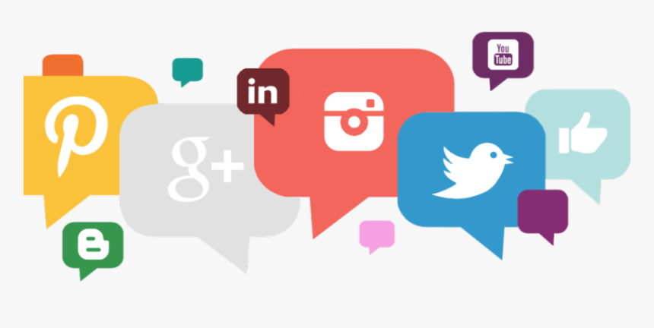
How have social media platforms changed the way we consume and understand information?
The development of social media such as Twitter, Instagram, TikTok, and YouTube has created an environment where information is constantly being thrown at us to consume at a rapid rate. Content is quickly cycled through the consumer’s feed as they scroll by. Because of the sheer amount of things you see, it is not uncommon for users to quickly share whatever information they find without checking it’s validity. This format also means our attention spans when reading articles have shortened. Many skim through the article ignoring important details or take a glance at the title and leave.
It is not all negative however, as social media can be a great way for people to learn about issues around the world. For example, when scrolling through your Instagram stories, you can easily find educational posts that talk about things ranging from global warming to human rights.

Slide 3
When you see or read “news” on social media, do you take the time to research the story further?
When it comes to finding anything I see on the Internet, I do my best to be doubtful of whatever I see. Especially on apps like Instagram on Twitter, I make sure to check the validity of the claims on fact-checking sites like snopes.com and truthorfiction.com. Because of how easy it is to share posts on social media, the truth may easily get lost or elaborated in the process, creating false rumours that cause panic and fear. By regularly checking with unbiased sites like the ones mentioned, I keep myself and the people around me informed.

Slide 4
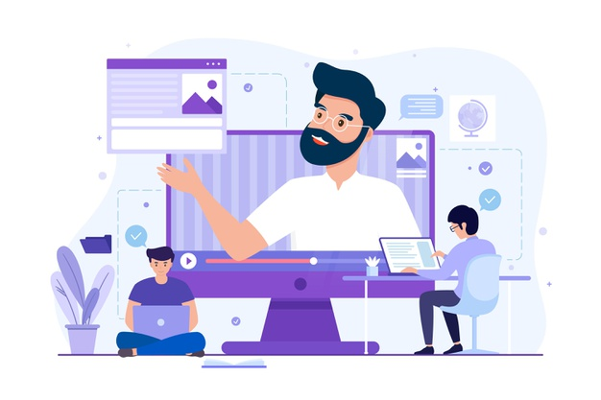
What is the value you get from online social interactions?
Online social interactions can easily provide value, as it makes it accessible for many to engage in communities of like minded people and make new friends. Those who feel lonely or isolated in real life can find company through the internet. It also gives people a space to share their ideas and creativity with a wide audience who can respond and give encouragement or criticism. Online social interactions are even more valuable during a time where it is unsafe to gather physically. Although it is not a perfect replacement, talking to peers on safe spaces such as Microsoft Teams and Google Classroom provide a great way to communicate and collaborate.

Slide 5
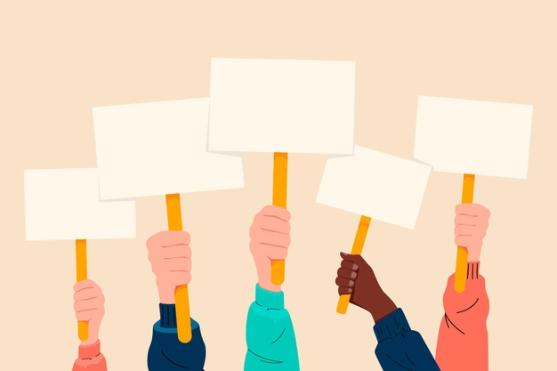
How is social media and social capital helping to form youth culture?
Social media and social capital is helping to form the culture of young people in both negative and positive ways. Kids are being exposed to the internet and social media at a younger and younger age. This can be both good and bad, as early exposure to social media increases the chance of becoming addicted and reliant on it for self-worth. But, it is also creating adults who are more aware of the issues around the world and want to be part of changing it. Social media is creating thousands of young activists through educational posts and popular figures such as Greta Thunberg and Jamie Margolin.
On the other hand, it is creating a generation that is overly self-conscious of how they look through the societal pressure of edited and filtered photos of popular social media figures that create unrealistic expectations for their body. This also increases the chances of youth developing mental illnesses such as depression, anxiety, and body dysmorphic disorder.

Slide 6
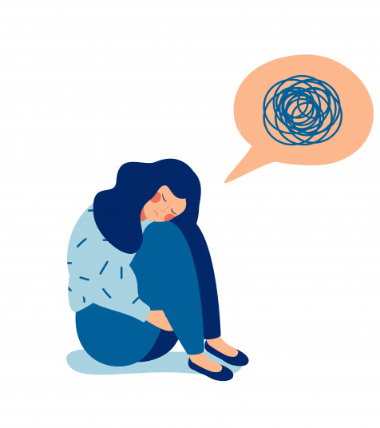
When you post online do you consider how the post may be seen by others? What may it say about you?
Yes, being on social media has impacted the way I see my posts. I often overthink about what will catch people’s eye the most and what time I should post to get the most attention on it as possible. I spend much more time than I should thinking up captions that people will find interesting or funny.
This shows how much the constant exposure to social media has effected my brain, making me hyperaware of what others think about me, both in person and online.

Slide 7
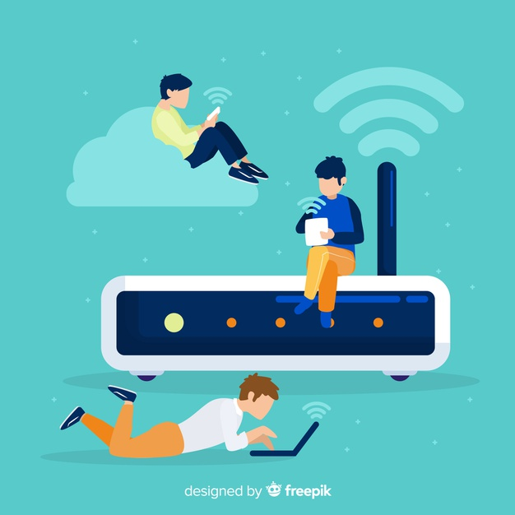
How may be that post seen in the future?
In the age of the internet, once you post something it is there forever. Doesn’t matter if you delete it, there are many websites dedicated to archiving things from social media. This is why I try to be careful when posting and making sure to leave a clean digital background. Future employers or people looking at university applications will most likely do a digital background check on you, which is why it is so important to keep your posts appropriate. Foolish things you posted on a whim that was forgotten a day can ruin your life a decade later as an adult.
Things can be easily dug up and tracked from your history online to destroy your reputation.

Slide 8
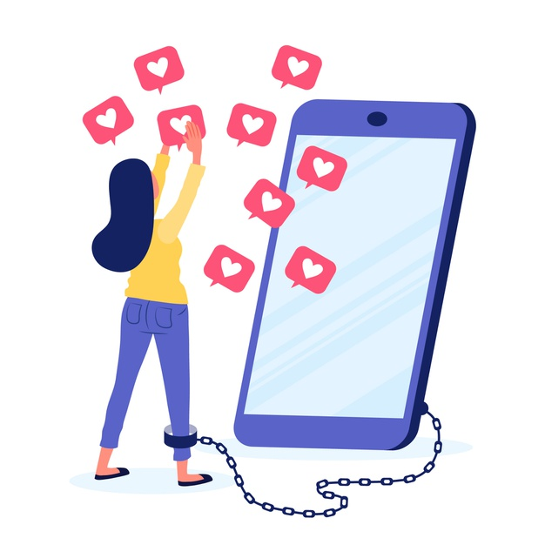
Do you see any similarities between the world presented in this video and the world you live in?
Similarities I found between the two worlds was that both inhabitants cared extremely about how others perceived them on social media. We are humans, and we want to be well liked by others, but the video showed how we can go as far as pushing someone down and joining the majority to be popular. Another similarity I saw was how the woman took a bite out of the cookie and spat it out just for a picture for her social media. This behaviour is common among popular models and influencers we often see who post about how great their lives are. They sacrifice their own well being for the validation of strangers on the internet, every action they do affected by what they will post next.

Slide 9
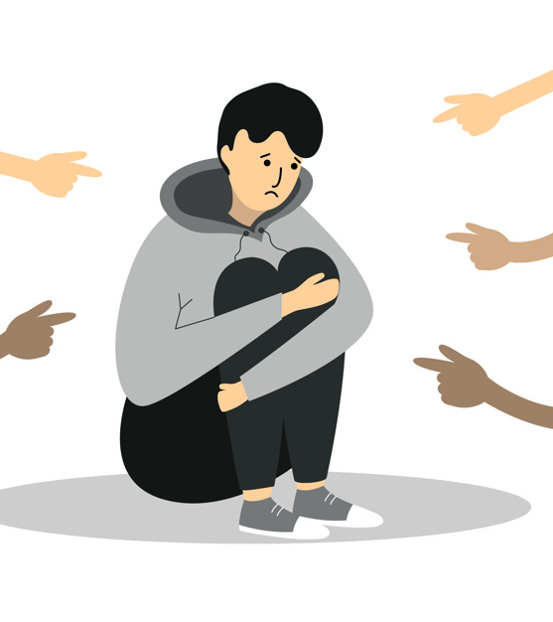
How does the main character gain and lose points? Why are these points important to her?
The main character in Black Mirror’s Nosedive gains and loses points through the ratings people she interacts with give her. This can be compared to someone’s reputation in real life, except that the point total isn’t out there for everyone to see. These are important to her because the society seems to revolve around these points. Having a low score can ruin your life like her co-worker, or hugely improve your quality of life. The better score you have, the better you are treated. Her position in her wide social circle all relies on having a good score so she does anything she can to improve it, such as posting a meal she did not enjoy for more ratings.

Slide 10
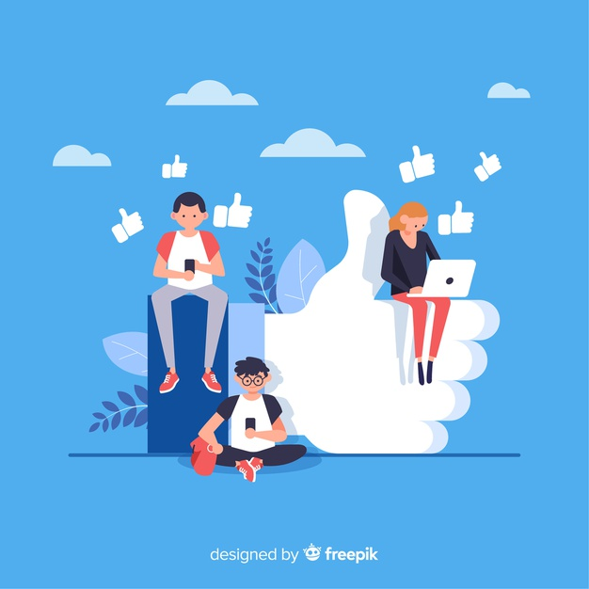
What value might be derived from this type of social interaction?
Some value, although small, can come from this type of social interaction, as it forces you to become more sociable and charismatic for the sake of your well being. To get a higher rating, people like characters in this episode have to make themselves look good or charitable, by doing things like selling healthy organic smoothies or complimenting others. Though the intention behind the actions may be selfish and for their own good, they are nevertheless still doing something positive from an outside perspective.

Slide 11
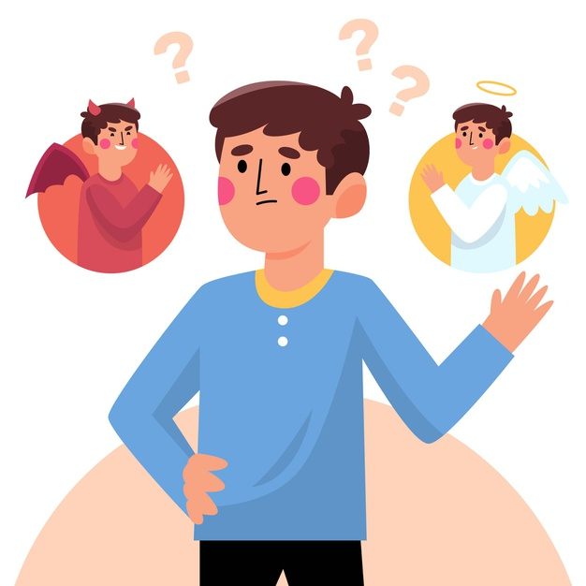
How are social interactions changed in the world of these clips?
Social interactions in this world are heavily based on the point tally of the people you talk with. Everyone has a selfish intention to their actions and they know others do too, yet they still do their best to look good to improve their rating. Like what the main character Lacie did, conforming to the majority opinion, even if she thought Chester was in the right.

Slide 12
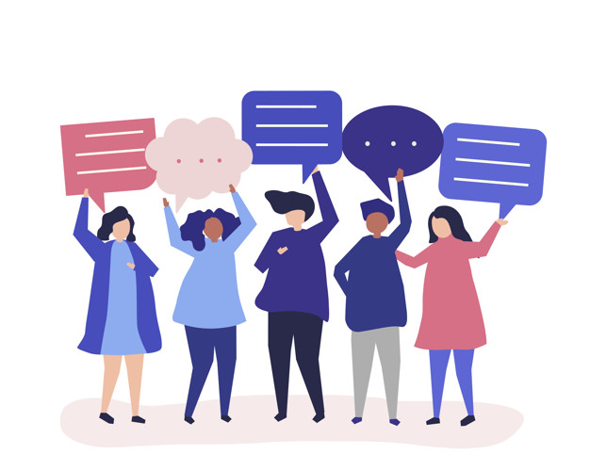
How did you tell the difference between facts and interpretations, opinions, and judgements?
You can tell the difference between facts, interpretations, opinions, and judgements by looking at what is said. A fact is something that can be proven and verified as true or false. Opinions on the other hand, are based off of feelings. They can’t be proven but they can be based off of facts. Interpretations is when you take multiple facts and form connections between them. Similar to this, judgement is when you evaluate something carefully to come to a decision.
These can be easily confused online, so I make sure to separate them by checking for the proof of facts and watching out for biased or opinionated news articles that may sway the reader in one direction.

Slide 13
How do you analyze evidence from different perspectives?
You can analyze evidence from different perspectives by looking for clues of biases that may be hidden throughout. Each new perspectives brings new context to the table. By looking for bias in each view, you can come to a conclusion of which information is correct and what has been glamourized or embellished by the story’s teller.

Slide 14
Citations
All images- Freepik. (2021, March 3). Graphic resources for everyone. https://www.freepik.com/

