Slide 1
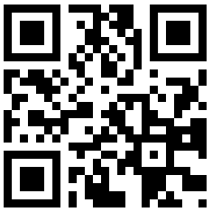
Take The Survey Now
To Log In: Use your Log In ID
Use your School ID:136-username
Then add @sd43.bc.ca
Your Username should be =>
136-username@sd43.bc.ca
Your password: School Password
Can’t Log In? Make sure you check with us during Flex!
This survey is Mandatory
Can’t Scan? Use this (ENSURE CAPS): bit.ly/DL10TFOX

Slide 2
Welcome to Digital Learning 2019-2020

Slide 3
What Do You Think of Digital Learning?

Slide 4
What is Digital Learning?
Critical Thinking and Problem Solving
Creativity and Innovation
Communication and Collaboration
Research and Information Literacy

Slide 5
Task Schedule and grade breakdown
Assignment | Percent
Intro Assignment – What is Digital Learning? Due: October 4th | 10 %
WordPress About Me Page – Using WordPress and Microsoft Teams Due: November 6th | 15 %
Digital Citizenship Assignment Due: December 13th | 15 %
Digital Footprint Due: March 4th | 15 %
Digital Advertisement Due: May 7th | 15 %
Core Competency Review Due: June 5th | 10 %
4 x Reflection Assignments * (5 % each) | 20 %

Slide 6
The 5 Core Tasks
About Me Page Assigned: September (Due: November 6th) | Digital Citizenship Assigned: Early November (Due: Dec 13th) | Digital Footprint Assigned: Early February (Due: Late Mar 4th)
Digital Advertisement Assigned: After Spring Break (Due: May 7th) | BC Self-Assess Core Comp Assigned: Early May (Due: Mid June 5th)

Slide 7
The 4 Reflection Assignments
Based on Classroom Activities
Complete 2 per semester
Each from a different course
Total Reflections for the year = 4
Reflection Due Dates are the same as the Core Assignment Due Dates
First : November 6th
Second : December 13th
Third : March 4th
Fourth : May 7th

Slide 8
Classroom Reflection Options
English | Math | Science
Socials | PE | Elective 1
Elective2 | Elective 3
Notes:
Fix and seperate

Slide 9
Assessment Rubric – Curricular Competencies We will be using a 4 point rubric scale to assess your understanding and demonstration of the curricular competencies on your reflections & core assignments
Communication & Collaboration
Research & Information Fluency
Digital Citizenship
Technology Operations and Concepts
Notes:
Communication
Blends the message and media digitally to effectively communicate
Research & Information Fluency
Explores, experiments, and innovates
Digital Citizenship
Expresses personal views and perspectives as a positive digital citizen.
Technology Operations and Concepts
Understands how to use navigational systems (e.g., scrolling, active windows, menus, buttons, etc.)

Slide 10
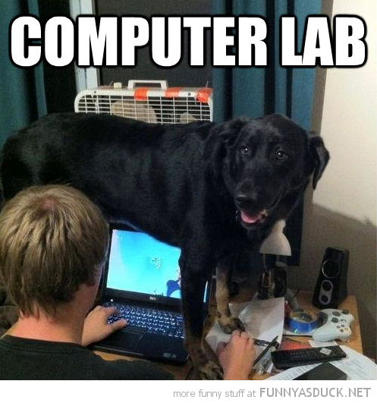
To be SUCCESSFUL…
You must sign into Flex in the library computer lab at least two times during a lesson cycle
During a 4-6 week cycle you should do:
One LESSON visit (Where we teach you HOW to complete the assignment)
One CHECK IN visit (Where you get support completing your assignment)
Notes:
Most Core Tasks are on a 6 week schedule,
Typical “Task Cycles”
3 weeks of lessons, repeated each week
3 weeks of help, no class instruction

Slide 11
The Flex Cycle
During Semester 1 we will complete THREE Flex Cycles:
Now & October 4th = 1 check in
October 4th – November 6th = 1 lab & 1 check in
November 6th – December 13th = 1 lab & 1 check in
EACH cycle starts with an assembly
Check out the Computer Lab windows in the Hallways for important DATES!!!!

Slide 12
Example Flex Cycle
Assembly to start the cycle
Lesson time
Check in time

Slide 13
Communication Devices:
Teams: To Submit Work
Terry Fox Blog
Complete Work
E-mail:
progress Reports

Slide 14
Digital Learning Reporting
Linear Timeline:
Semester 1, Term 1 Report Card = November
Progress Report emailed = January
Semester 2, Term 1 Report Card = April
Progress Report emailed = May
Semester 2, Term 2 Report Card = June
FINAL GRADE FOR DIGITAL LITERACY

Slide 15
Website Introduction
http://terryfox.sd43.bc.ca/
Notes:
Manual Guide of Websites

Slide 16
First Assignment Details
Notes:
Go Over First Assignment

Slide 17
Summary
Need Help
Come Visit - In the Library Lab In Flex
Next Theater and 1st assignment due
Oct 4th
Questions?

