Slide 1
Blackburn lagoon digital project

Slide 2
My picture
When I went to the lagoon I saw these lavender plants and I saw a bee land on it I saw it shaking on it and thought its pollinating I tried to get a picture of it but didn’t want to disturb it.

Slide 3
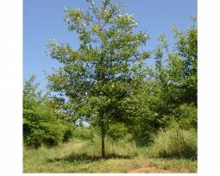
Black cotton wood tree
I saw this tree at the lagoon and I did research on and it is good for food, bugs, river, stream, and birds. It is good for birds because dome birds eat leaf's and some birds eat the bugs on the tree.

Slide 4
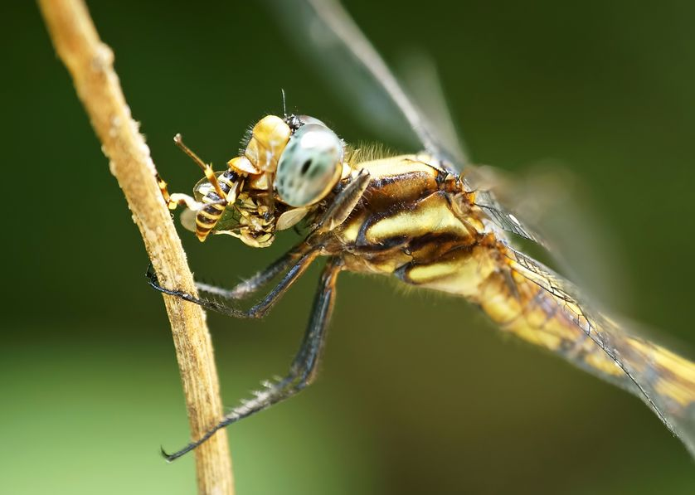
The dragon fly I saw
(My research) Adult dragonflies mostly eat other insects particularly midges and mosquitoes. They also will eat moths butterflies and smaller insects. Bigger dragonflies eat small fish or bigger insects.

